Slide 1
Rapid Responder Easy Alert Training
July 2016 update
Washington Association of Sheriffs and Police Chiefs
Program Manager
David Corr dcorr@waspc.org
(360) 561-0807

Slide 2
Rapid Responder Easy Alert
Rapid Responder is a program used by the Washington Association of Sheriffs and Police Chiefs (WASPC) to assist schools, colleges, and other facilities in the handling of emergency situations. It is accessed by facilities and first responder personnel in training drills, exercises, and real incidents via the internet
Easy Alert has been developed and tested in several school districts and is now available statewide for FREE.

Slide 3
Real World Uses
Monroe School District – users documented a school bus accident, allowing multiple users to be notified simultaneously, and for the driver to share a photo of a hand written chart of which students were on the bus at the time of the accident.
Spokane Community College – security staff communicated details of the need for emergency medical assistance when a faculty member exhibited symptoms of a heart attack.
Evergreen School District, Vancouver – staff shared a picture of a calculator screenshot which contained a death threat against a teacher.

Slide 4
Rapid Responder Easy Alert
Buttons – Designated school personnel are given access to create individualized alert “buttons” which can be installed on one or more computers, smartphones, or tablets. School staff and first responders can receive notifications that an event has been initiated. The event shows immediately on the Rapid Responder dashboard. Staff are trained and instructed to Always dial 9-1-1 first

Slide 5
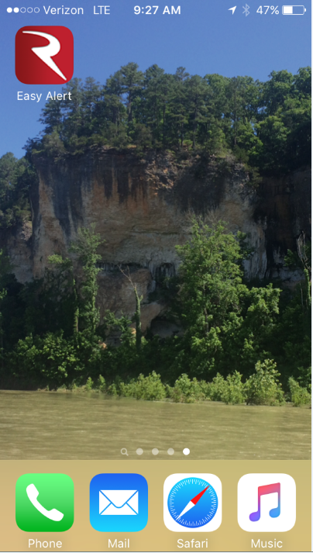
From any Internet Device

Slide 6
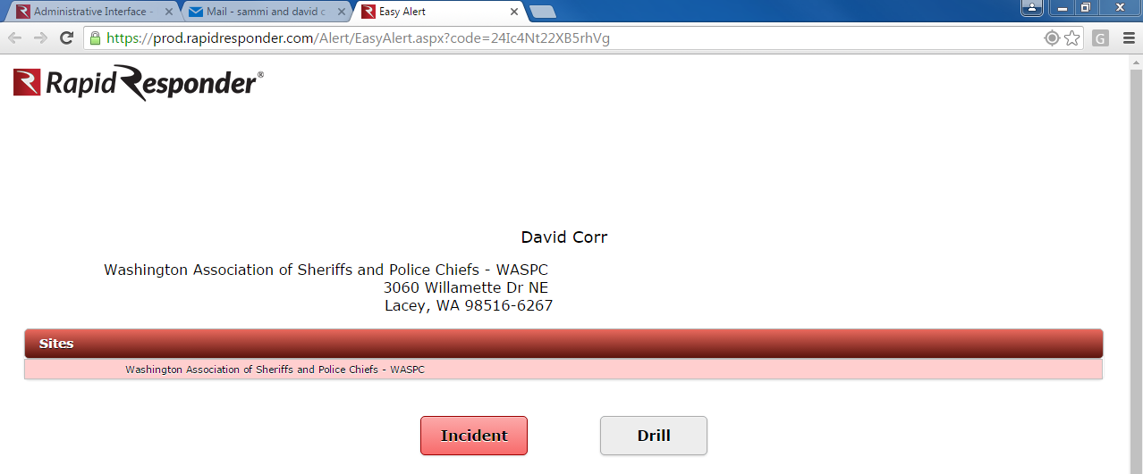
Rapid Responder Easy Alert
User opens the shortcut icon and then presses either Incident or Drill

Slide 7
Event Appears in Rapid Responder Dashboard
Allows any user with access to site to go immediately to appropriate information about the site, or to the event ICS features.

Slide 8
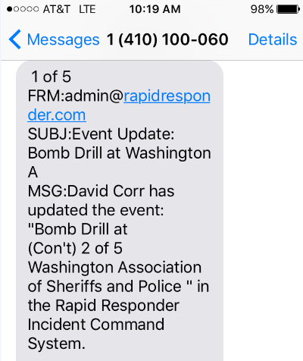
Notifications
Users who have signed up, receive email and/or text alerts.

Slide 9
User Begins to Communicate with Rapid Responder

Slide 10
Incident Command Communications

Slide 11
Subsequent Users Join in ICS Communications

Slide 12
Users Can Take Photos or Upload Photos Already on Device

Slide 13
Users Can Indicate Their Position by Latitude/Longitude

Slide 14
Clicking on the Link Indicates User Location in Default Map Program

Slide 15
District Users Can Initiate or Join Events at Multiple Events

Slide 16
Rapid Responder Users Can Share Texts and Photos

Slide 17
Information is Stored by WASPC’s School Safety Support Program
Washington State’s system has a specific statutory exemption from public disclosure for all information stored through the School Safety Support Program. RCW 36.28A.060

Slide 18
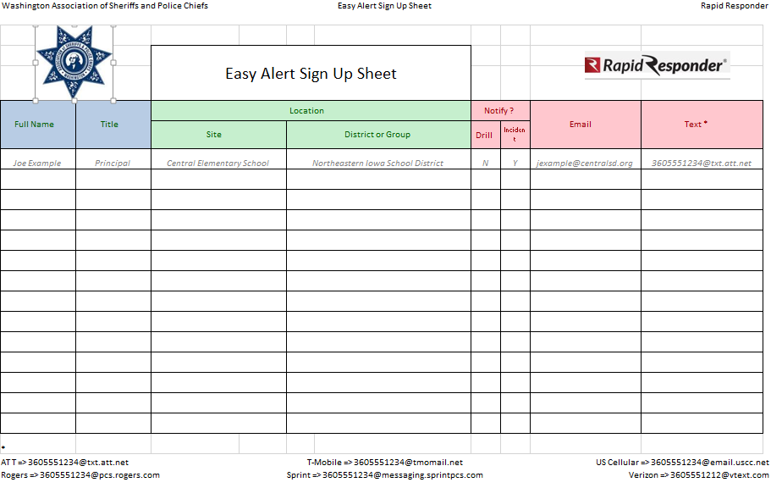
Easy Alert is FREE
Rapid Responder Users can now use Easy Alert for free.
Request orientation and training via the contact page at the end of this presentation.

Slide 19
For More Information Please Contact

